Slide 1

EDA ON AMEO 2015

Slide 2

About me
Name: Nikhitha Reddy
Background
B-tech in Electronics and communication Engineering
Why you want to learn Data Science
As Data is generating from everywhere which is crucial for drawing insights and analysis. Also the Data science and Artificial Intelligence are going to rule the world in the coming years. So, with the interest to be in the part of this Domain and keen to draw insights, build models I chose Data Science.
Any work experience
Fresher
Share your linkedin and github profile urls
https://www.linkedin.com/in/nikhitha-chinthala-a49b5b200/
https://github.com/Nikhitha-2310

Slide 3
Introduction
The EDA project is provided with the dataset of Aspiring Minds Employees which has 3998 data points and around 38 feature variables and one class variable. The feature variables contain the employee’s id, their education background, test scores in different domains, designation, class variable being salary of each employee.
The objective of the project is to find the features through which salary of the employee is getting effected.
The dataset is not found using web scraping, it was released by Aspiring Minds from Aspiring Minds Employment outcome 2015.

Slide 4
Data cleaning and analysis
The raw data contains few data type issues with the features, so I had changed the data types of each feature respectively.
Other than the above issue, there are no issues with the dataset.
After the data is cleaned, I had performed Univariate analysis on each numerical and categorical feature, Bivariate analysis of each feature variable with respect to the class label and found the features which are affecting the salary.

Slide 5
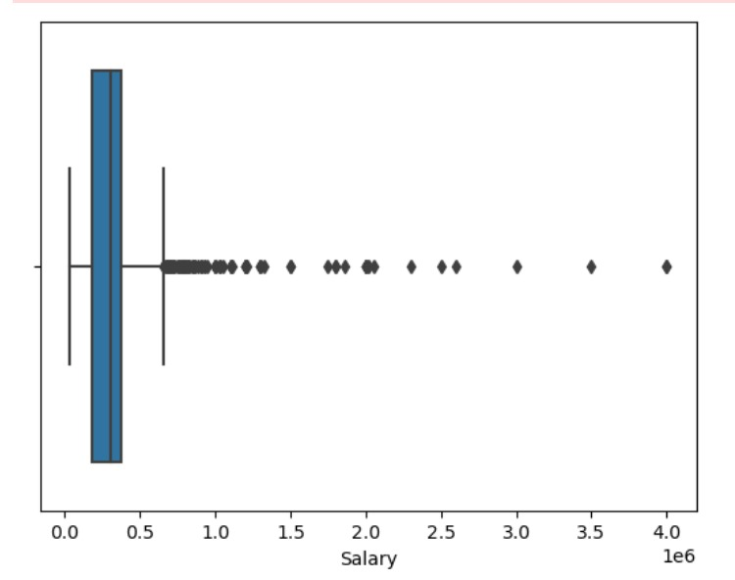
Salary range
The salary of 50% of the employees are ranging till 5lakhs. There are few employees getting till 7lakhs and very few employees are getting 15lakhs to 40lakhs which are exceptionally high compared to the lower salaries.

Slide 6
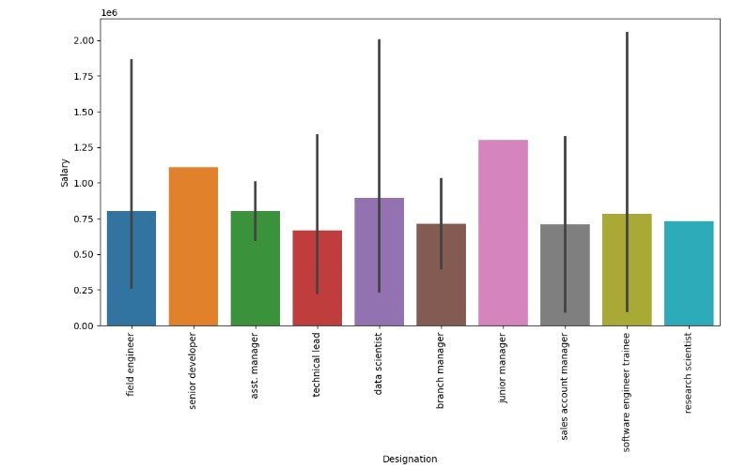
Analysis on variations of Salary with Designation
The salary is varying with the designation of each employee, the average salary is high for junior manager with around 12lakh followed by senior developer.

Slide 7
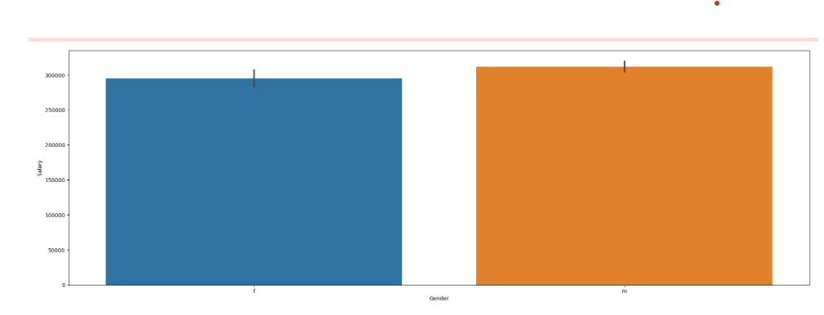
Analysis on variations of Salary with Gender
The salary is slightly higher for male compared to female

Slide 8
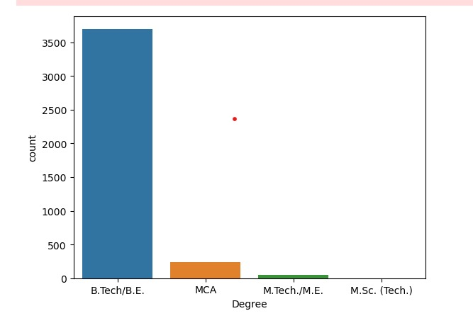
Degree
Around 3600 employees in the company belongs to Btech/B.E and a very few employees are from MCA, Mtech/ME, MSC background

Slide 9
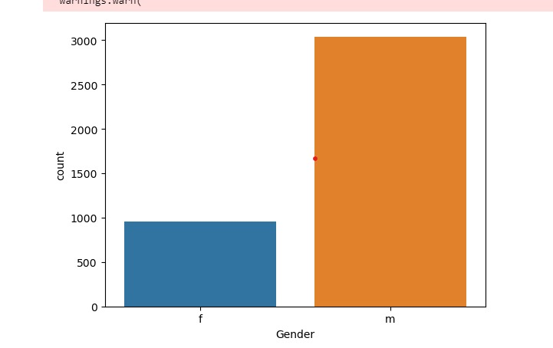
Gender
There are more number of male employees in the company compared to female employees.

Slide 10
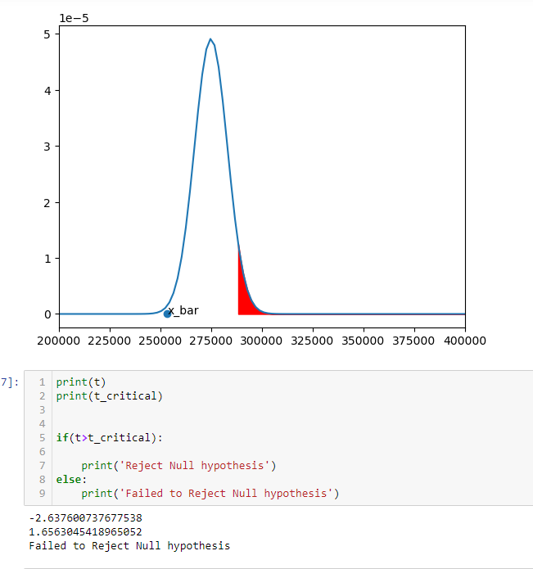
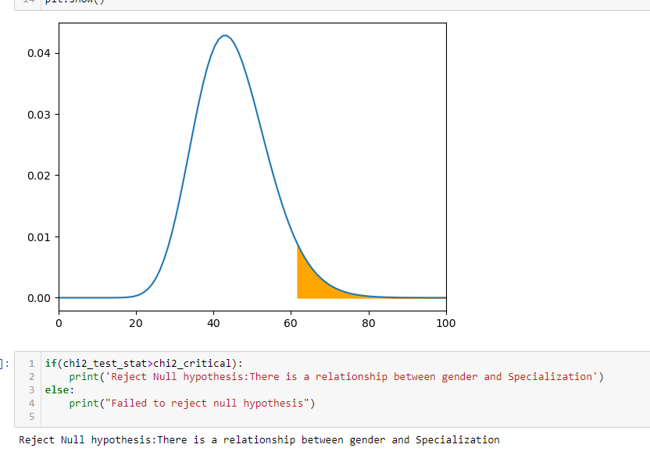
Research questions
The claim stated by the Times of India regarding the salary of computer Science Engineering students in the roles like Programming Analyst, Software Engineer, Hardware Engineer and Associate Engineer as fresher can earn 2.5-3 lakhs is true. The Null hypothesis given by the Times of India can be accepted.
There is a relationship between the Gender and the Specialization. There are more number of females in the specializations related to software industry compared to the hardware. The female count is very less in hardware branches, and male count is high in both software and hardware branches.

Slide 11
Conclusion
From the analysis done on Aspiring minds employees , the salaries of the employees is varying based on different features. The salary of most of the employees is below 5lakhs, The maximum number of employees are from Btech and Software Background. In the company, there is a domination of male count over female count. The salary of employees is not depending on any of their 10th or 12th grades and also the test scores conducted by the company in each domain. The salary is varying based on the designation, specialization, their Degree. The employees with MTech degree has the higher salary compared to other degrees. On top of all male employees has the higher salaries compared to female employees.

Slide 12


Slide 13

THANK YOU

